Slide 1
RAISING THE BAR FOR HIGH FRICTION SURFACING
Steve McGilchrist
WJ Group Business Development Manager

Slide 2

Intro HFS video

Slide 3

Properties of High Friction Surfacing
Thin overlay surface treatment – non structural
Incorporates calcined bauxite aggregate
High surface macro-texture
High aggregate micro-texture
Highly skid resistant
Aggregate is highly resistant to polishing

Slide 4

Background
1960s UK
Significant increase in road traffic
Increases in KSIs
Road deaths peaked at 7,985 in 1966
‘Black Spots’ identified at bends, junctions and pedestrian crossings

Slide 5

Development
Greater London Council study in 1965
70% of all accidents occurred within 15m of junctions, crossings etc.
Partnership of GLC/Shell/Met Police/TRRL
HFS first trialled in 1968
Shell two-component bitumen-extended epoxy resin binder
Calcined bauxite aggregate

Slide 6
Outcomes
Accidents and casualties halved in year 1
10 year programme was instigated
Programme cost was covered 8 fold in reduced accident costs
Effective life of HFS found to exceed 10 years
First system marketed as ‘SHELLGRIP®’
HFS specified in Series 900 of the Specification for Highway Works – Clause 924
Notes:
Safety benefits backed up in later studies

Slide 7
HFS saves lives and money
HFS has been found to reduce wet weather accidents by 57% and could reduce the overall number of accidents on our roads by 5.5%
(TRL Research – BRF Road Fact 1997)
1,700 sites treated in one year with HFS at a cost of £3 million saved us £24 million through accident prevention
(The London Accident Analysis Unit)
34 Schemes with an average cost of £8620 reduced accidents by 57% and gave a first year rate of return of 352%
(RoSPA)

Slide 8
Why use High Friction Surfacing?
Immediately reduces skid-related injuries and fatalities
Most effective at high-stress sites
Provides a sustained higher level of skidding resistance than that achievable with any alternative type of surfacing

Slide 9
Design Manual for Roads and Bridges
CD 236
Surface course materials for construction Revision 3
Tables 3.2a and 3.2b are the same for HFS purposes

Slide 10
Specifications, Quality and Regulation
Manual of Contract Documents for Highway Works (MCHW)
  Volume 1 Specification for Highway Works
    Series 0900 Road Pavements
    Clause 924 High Friction Surfaces
Clause 924 currently requires that the HFS system is certificated and installed to HAPAS or an equivalent product acceptance scheme. THIS IS DUE TO CHANGE.
Notes:
Early 1990s
Need for system of approval for highways products and treatments not covered by existing standards
1995 –
Highways Authorities’ Product Approval Scheme (HAPAS) – a national approval and certification process for innovative products, materials and systems used in highways and related areas
British Board of Agrément (BBA) was asked to administer the scheme
HAPAS is supported by a technical advisory committee (known as HiTAC) which includes representatives from the BBA, HE, ADEPT, TAG, MPA, HTMA, CECA
HAPAS HFS is now directly referenced in SHW, Clause 924 and in DMRB, HD36/06
Each product scheme operated under HAPAS has a steering group. HFS is run by Steering Group 1 (SG1)

Slide 11
Types of HFS System
Definition based on the type of binder
2 generic types:-
THERMOSETTING = COLD-APPLIED
THERMOPLASTIC = HOT-APPLIED
Notes:
Cold = Bonded
Hot = Bound

Slide 12
HFS Product Timeline - UK
1960s
Bitumen extended epoxy
1980s
Polyurethane (or PU or PUR)
Thermoplastic
2000s
Methyl methacrylate (MMA)
Clear epoxy
Polyurea
2010s
PU modified MMA

Slide 13
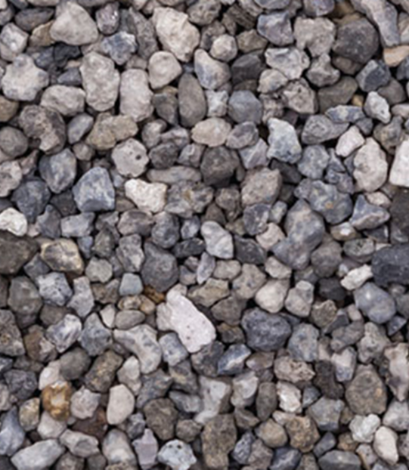
Types of HFS System
‘THERMOPLASTIC’ & ‘THERMOSETTING’ only refer to the resin binder element of the system
Systems may also contain fillers, plasticisers, aggregates, oils and other components
However, ALL HFS systems require
CALCINED BAUXITE

Slide 14
Why Calcined Bauxite?
Manufactured aggregate
Has properties not matched by natural aggregate
Exceptionally hard - MOHS hardness of 9
Extremely resistant to abrasion AAV≤4
PSV 70+
Highly resistant to polishing
Calcined bauxite - the defining constituent of HFS
Notes:
AAV ≤10-16 allowable in UK

Slide 15
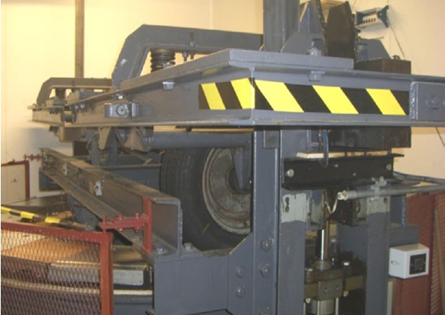
Skid Resistance After Trafficking
Testing was carried out using the Road Test Machine (RTM) for a total of 100,000 wheel passes. The RTM is used to simulate slow speed/high stress trafficking in laboratory controlled conditions.

Slide 16
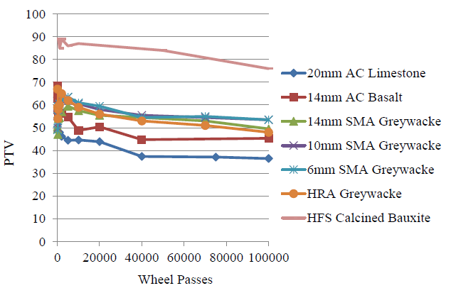
Average skid resistance after simulated trafficking
Source - Predicting the Wear of High Friction Surfacing Aggregate
Woodward & Friel 2017

Slide 17
Overall Findings
Cost
Accident statistics from multiple sources show that, where used appropriately, the quantifiable benefits of HFS in reducing collisions and KSI occurrences far outweigh its cost.
Durability
BBA Technical Report 2 (2015) concluded that, on average, thermoplastic HFS lasted 8 years and thermosetting HFS lasted 12 years at or above an ‘acceptable’ level as defined in TRL Report 176.
Performance
TRL Published Project Report PPR789 found that the unique hardness and resistance to polishing of calcined bauxite means that the skid resistance of HFS starts high and does not deteriorate over time in the same way that it does with surfacing materials using high PSV natural aggregates.

Slide 18
Selecting a High Friction Surfacing System
CURE SPEED
ALL HOT APPLIED
EPOXY
POLYURETHANE
PERFORMANCE

Slide 19
Selecting a High Friction Surfacing System
CURE SPEED
ALL HOT APPLIED
MMA
POLYUREA
EPOXY
POLYURETHANE
PERFORMANCE

Slide 20
The Issue Today
Estimated area of HFS installed in the UK
        Mid 2000s ~ 3,500,000 m² per year
        Now ~ 750,000 m² per year
A decline of nearly 80%

Slide 21
Reasons
Lower client awareness of the safety benefits of HFS
Financial benefits do not come back to road operator
Local authority budget cutbacks
Local authority highways funding diverted to e.g. adult social care
Perceptions of low durability
Products promoted as alternatives to HFS, e.g. high PSV asphalts
HAPAS scheme

Slide 22
HAPAS
Introduced in 1998
Administered by the British Board of Agrément (BBA)
First product acceptance scheme for HFS
Assessed product and its installation
3 performance categories – Types 1 to 3 (1 is highest)

Slide 23
Why change?
Felt that HAPAS scheme had not responded to newer, more durable HFS systems
Ceiling on performance classifications meant that better products could not be differentiated
Highways Agency (now National Highways) in England wanted to be able to specify better products
Legal dispute over ownership of HAPAS

Slide 24
New British Standard – April 2022

Slide 25
Comparison
Notes:
The higher the BBA Type classification, the higher cv/day and the more onerous the site category
Type 1 is 2500 to 3500 cv/day depending on site category
Various laboratory and site performance criteria have to be met, incl. min SRV, min texture depth and max erosion

Slide 26
BS 8870
Builds on experience from BBA scheme
Satisfies direction of travel of main strategic road network (SRN) clients
Linked with NHSS 13 for installation
Introduces modified test procedures specific to HFS
Replaces tensile adhesion test with surface shear strength test
Phases in micro-Deval test to replace AAV
No ceiling on performance classifications in future
Can be refined as learning takes place during use

Slide 27
Future Objectives
BS 8870 will allow better performance standards to be achieved and recognised
Durability and product lifecycle can be better monetarised
Client confidence will be raised
Use of HFS will increase
More lives will be saved and serious injuries averted

Slide 28
Carbon
Supply chain is ready to participate
Some companies have carried out considerable work
Too many different carbon calculators
Need level playing field
Need definitive calculator from top client i.e. DfT

Slide 29

Thank You
Steve McGilchrist BSc
WJ Group Business Development Manager
Contact Details
M: 07881 684125
E: steve.mcgilchrist@wj.uk
W: wj.uk

