Slide 1
An Introduction to the Institute of Highway Engineers
Steve Spender CEng HonFIHE
Chief Executive
Institute of Highway Engineers
Notes:
RH SECTION

Slide 2
Introduction
Who are the Institute of Highway Engineers (IHE) ?
Established in 1965 and have been licenced by the Engineering Council since 1972
Institute of choice for specialist highway and traffic practitioners
Expertise in all areas of traffic engineering
Notes:
RH SECTION

Slide 3
The Institute of Highway Engineers
Our Vision:
“To support Highway and Traffic Engineers at every stage of their career”
We have over 3,600 members of which more than 50% are professionally registered.
We are Licensed by Engineering Council & British Computer Society to register Engineering Technicians, ICT Technicians, Incorporated Engineers, Chartered Engineers and Chartered IT Professionals.
We are the only Engineering Council Institute dedicated to serving the needs of engineering professionals in the highways sector.

Slide 4
The Institute of Highway Engineers (IHE) :-
Professionally Register:
Chartered Engineer (CEng), Chartered IT Professional (CITP),
Incorporated Engineer (IEng),
Engineering Technician (EngTech) and
Information Communication Technology Technician (ICTTech)
The letters in brackets are the post-nominal letters (Letters after your name) attained after you have successfully registered at each level

Slide 5
The IHE also:-
Accredit HNC, HND, Degree and Masters courses as part of the Joint Board of Moderators (JBM) with ICE, IStructE & CIHT. (Check the qualification you are studying is a degree that is accredited ) https://www.engc.org.uk/education-skills/course-search/
Accredit company training schemes
Awards Professional Certificates and Diplomas for specialist subjects. (These are generally applied via work based learning)

Slide 6
IHE Highway Engineering Academy
Offering Professional Certificates & Diplomas in subjects such as:
Temporary Traffic Management,
Asset Management,
Transport Development Management.
Traffic Signal Control from Design to Implementation.
Highway Maintenance,
Winter Services Decision Making.
Transport Network Resilience,
Traffic Signs and Road Markings
Road Safety Engineering
Active Travel Planning & Design.

Slide 7
IHE involvement within the Highways Sector
Responsible for the administration of:
Highway Inspectors Register
Road Safety Auditors Register
Highway Inspectors (Streetworks) Register
Memorandum of Understanding with the IAT
Partnering with RSTA
Links with NWSRG
Links with Highway Magazine

Slide 8
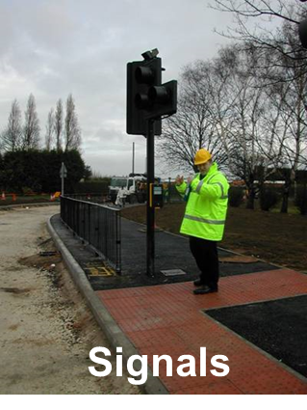
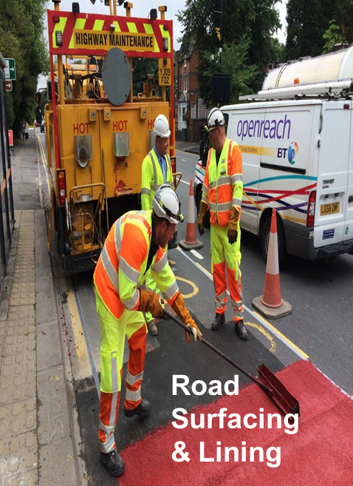
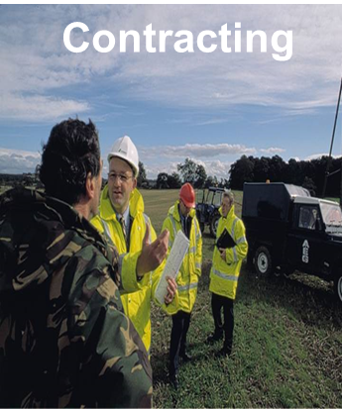
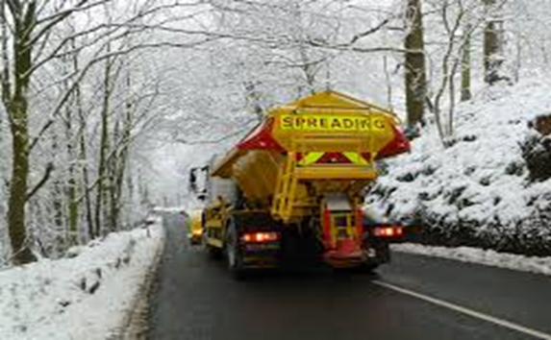
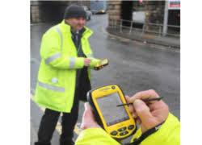
Typical Members
Highway Inspectors
Winter Maintenance

Slide 9
IHE Publications
The IHE has published several documents as well contributing to many other important documents used in the highways sector
Traffic Control and Information Systems (IHE 2020)
Winter Services Guidance Documents, (NWSRG & IHE, 2019/2020)
Well Managed Highway Liability Risk (IHE 2019)
Winter Maintenance Handbook (IHE & Highways Magazine 2016)
Sign Structures Guide (IHE 2010) – Currently being revised
IHIE Guidelines for Motorcycling (IHE 2005)
Home Zones Design Guidelines (IHE 2002)

Slide 10
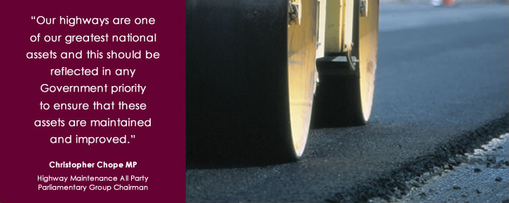
IHE support for All Party Parliamentary Groups
Working along side the AIA the IHE sponsors the APPG for Better Roads which in 2021 will be working with Sir Christopher Chope in delivering an enquiry and report into Highway Maintenance on Local Roads.
The Institute is also a supporter of the APPG for Cycling & Walking attending regular meetings and briefings.
Building on the ‘Active Travel’ agenda.

Slide 11
Developing a working Relationship with the Highways Sector

Slide 12
Joining the
Institute of Highway Engineers
Notes:
RH SECTION

Slide 13
IHE Membership Grades
Student Member -
Open to anyone studying a full or part-time qualification in a Highways/Civils/Transportation related subject
Affiliate Member -
Open to Professionals working in the industry (not necessarily an Engineer)
Associate Member: AMIHE
Open to engineers with relevant engineering qualifications and / or 1 to 5 years experience in the industry.

Slide 14
IHE Membership Grades ( Continued)
Member: MIHE
An Engineer with an accredited Degree plus two years experience
or
An Engineer with 10 years experience (demonstrating a minimum of three in a responsible position)
or
Possess EngTech registration.
Fellow: FIHE
An engineer with 15 years experience (with five years in a responsible position)
or
Possess IEng or CEng registration.

Slide 15
Professional Registration
Advice & guidance on the steps towards becoming a Professional Engineer:
You will need to apply for a Professionally Registered grade in addition to your membership grade. Once successful, you will have Post Nominal letters after your name.
The grade you apply for is dependent on your academic qualifications combined with the amount of industry experience that you have attained.
https://www.theihe.org/professional-registration

Slide 16
Professional Registered Grades
The IHE offer the following Registrations
Engineering Technician EngTech
Incorporated Engineer IEng
Chartered Engineer CEng
Registered IT Technician RITTech
Chartered IT Professional CITP
ICT Technician ICTTech
All guidance documents on how to become professionally qualified are on the IHE website.

Slide 17
Benefits of Membership
eBulletin every week – containing jobs, news, technical papers and events
Access to local Branch meetings & visits with opportunity to join
Members area on IHE website with forums, document downloads and networking opportunities
Discount on Training Courses & Events
CPD HUB & CPD Recording Tool
Online Technical Forums
Member’s Pages in Highways Magazine
FREE Subscription to Highway Magazine

Slide 18
Benefits of Professionally Registered Status
Demonstrates personal success
Is held in high regard by the engineering industry and employers
Is an internationally recognised qualification
Recognises achievement without the need for formal academic study
Transferable and relevant across engineering
Entitles use of internationally recognised post-nominals after your name

Slide 19
“I would encourage any highway engineering practitioner to think about seeking professional registration and joining the Institute of Highway Engineers.”
You can apply online through the IHE website.
https://www.theihe.org/membership/membership-types/

Slide 20
Thank you for your time
Any questions please contact –
Steve.spender@theihe.org
Notes:
RH SECTION

