Slide 1
The Importance of Interlayer Bonding in Pavement Construction

Slide 2
introduction
Why is the topic so important?
Bond Coats and Tack Coats
What is an interlayer bond?
What about waterproofing?
Application

Slide 3
Dr Stephen Tweed, SHE and Pavement Engineer from the Department for Infrastructure
in Northern Ireland states
“In recognition of the importance on interlayer bonding within pavement structures, the application of bond coat in conjunction with each bituminous layer installed is a current requirement within NI road surfacing contracts. Effective bonding between pavement layers is regarded as a key element in providing more durable, longer lasting assets with lower maintenance requirements, reducing the risk of premature failure resulting from layer delamination or water ingress into the pavement structure. The use of high quality bond coat, between each pavement layer, is considered a fundamental requirement for the delivery of more sustainable pavements with increased service life and whole life value.”
Dr Stephen Tweed, SHE and Pavement Engineer from the Department for Infrastructure
in Northern Ireland states
“In recognition of the importance on interlayer bonding within pavement structures, the application of bond coat in conjunction with each bituminous layer installed is a current requirement within NI road surfacing contracts. Effective bonding between pavement layers is regarded as a key element in providing more durable, longer lasting assets with lower maintenance requirements, reducing the risk of premature failure resulting from layer delamination or water ingress into the pavement structure. The use of high quality bond coat, between each pavement layer, is considered a fundamental requirement for the delivery of more sustainable pavements with increased service life and whole life value.”

Slide 4
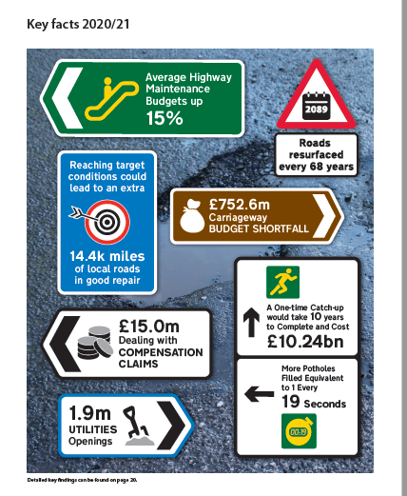
Why is the topic so important?

Slide 5
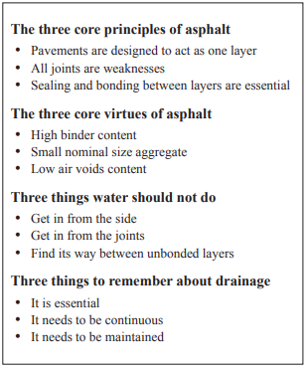
Why is the topic so important?

Slide 6
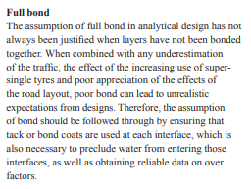
Why is the topic so important?

Slide 7
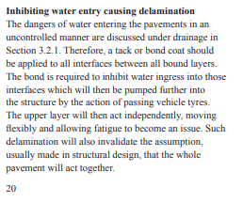
Why is the topic so important?

Slide 8
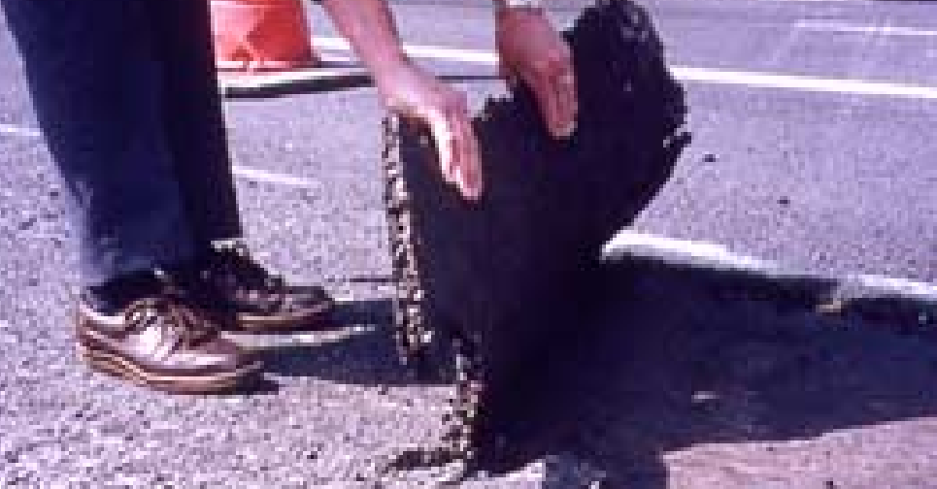
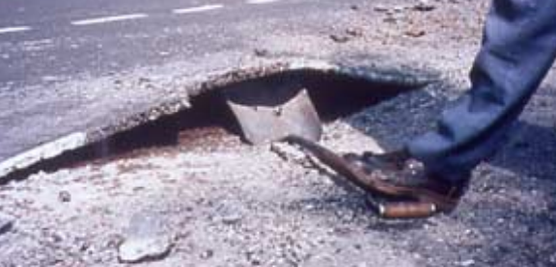
Why is the topic so important?

Slide 9
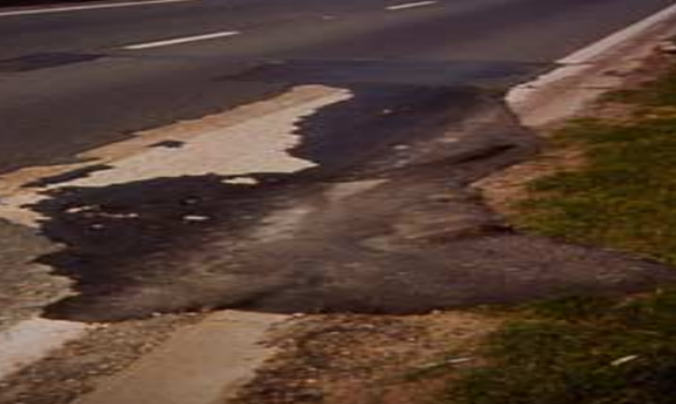
Why is the topic so important?

Slide 10
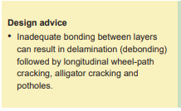
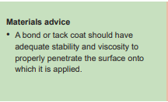
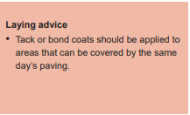
Why is the topic so important?

Slide 11
Bond Coats and Tack Coats
SHW 900 series - Clause 920
Tack Coats – Relatively low binder content, basic bitumen emulsion
Bond Coats – Relatively low binder content, polymer modified bitumen emulsion. Defined by cohesion levels >1.0J/cm2
Defined by BS EN 13808
Eg
50
C
B
P
3
Break index class
Mid point binder content
Polymer modified
Cationic
Presence of bitumen

Slide 12
Bond Coats
Generally increased cohesion provides a greater resistance to movement in all dimensions
Enables some relaxation of strain within the bond
Movement here

Slide 13
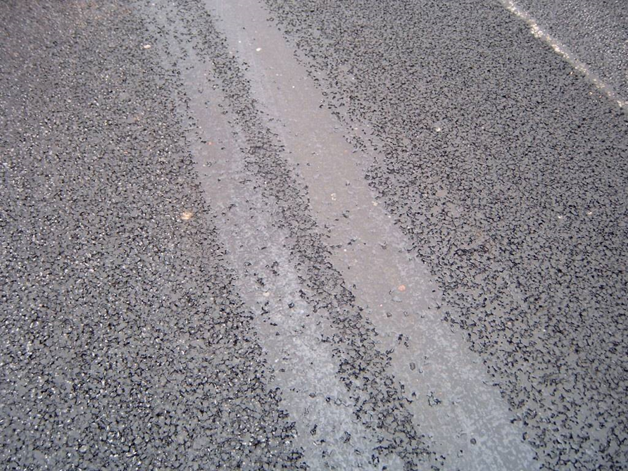
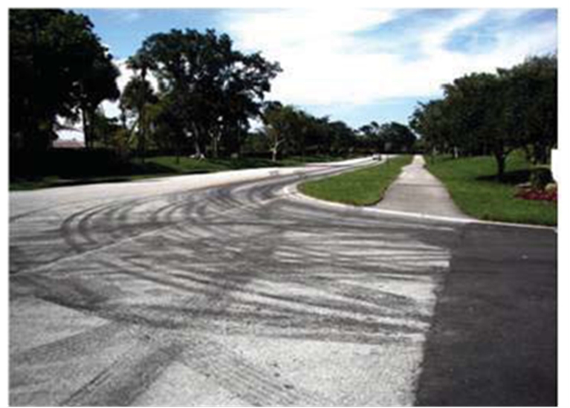
Bond coats
Where the binder is picked up on hot tyres, it can carry off onto other areas
2 impacts… - loss of texture where it is dropped off
- removal of bond coat from where it should be

Slide 14
Bond Coats
“Non Tacky” Bond coats
Resistant to “sticking” to site vehicle tyres
Harder bitumen that is resistant to tyre pick up
Melts into the newly laid asphalt

Slide 15
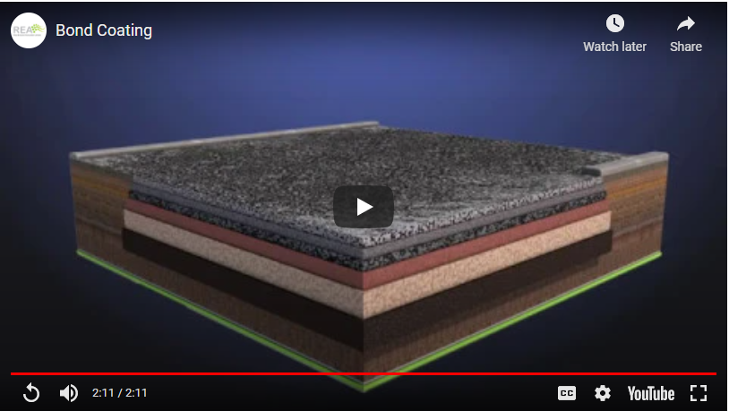

Slide 16
Alan Ferguson, former President of the Institute of Asphalt Technology and currently Materials Advisor for Asset Management of Roads in Transport Scotland says
“The proper application of bond coat between all asphalt layers is vital to maximise the life of our asset. Indeed, it is my view that bonding and sealing all asphalt layers combined with the correct level of compaction results in a structural layer that can significantly exceed design life. “

Slide 17
What constitutes an interlayer bond?
Traffic Force
“Monolithic Structure”
Surface Course
Binder Course
Good
Interlayer
Bonding
Base Course
Well bonded structure effectively spreading stress

Slide 18
What constitutes an interlayer bond?
Poorly bonded structure
Traffic Force
Premature development of Fatigue cracking (alligator cracking)
Tension
Strain
Tension

Slide 19
What constitutes an interlayer bond?
Poorly bonded structure
Traffic Force
Development longitudinal wheel track cracking)
Shear force
Strain
Shear Force

Slide 20
Research evidence
There is plenty of evidence that unbonded structures reduce the life of the Pavement significantly
Roffe and Chaignon in 2002 suggested that 60% loss of pavement life can be expected
Peattie in 1980 completed a report illustrating the high number of sites failing due to poor interlayer bonding
NCAT have modelled the phenomenon previously discussed where they illustrated the independent movement of the surfacing layer led to early cracking failure

Slide 21
Water impact
Well bonded structure inhibits water going through structure and getting into lower layers
If water comes laterally it stops migration through the structure

Slide 22
Stuart Evans, Pavement Manager, from the Department for Economy and Infrastructure for the Welsh Government
“Full bonding coverage of surfaces between interlayers has been a critical requirement in the drive to improve the quality of Welsh Government surfacing works. Recurring issues such as de-bonding, joint failure, water ingress and the rapid deterioration of mats in winter months are all symptomatic of insufficient bond coat application. Increasing rainfall levels and temperature variability are challenges we face over future years - desirable design life can only be attained by good quality control and thorough bond coat application”
Stuart Evans, Pavement Manager, from the Department for Economy and Infrastructure for the Welsh Government
“Full bonding coverage of surfaces between interlayers has been a critical requirement in the drive to improve the quality of Welsh Government surfacing works. Recurring issues such as de-bonding, joint failure, water ingress and the rapid deterioration of mats in winter months are all symptomatic of insufficient bond coat application. Increasing rainfall levels and temperature variability are challenges we face over future years - desirable design life can only be attained by good quality control and thorough bond coat application”

Slide 23
Application – BS 594987

Slide 24
X
Application – BS 594987
< 0.2l/m2 residual
Inadequate free bitumen available to bond the layers
Inadequate free bitumen to waterproof
Asphalt Layer
X
Significantly > 0.35l/m2 residual
Excess of bitumen potentially creating a “slip plane”
Potential bleed through of binder on asphalt application
Asphalt Layer
✓
Asphalt Layer

Slide 25
Application
Bond Coat application – Not tack coat (only by exception)
Machine laid – Not hand laid (only by exception)
Accurately control the ROS
Pre work check of “Tray Test BS 1707” to validate eveness of spray
Tested on site via carpet tile test for ROS

Slide 26
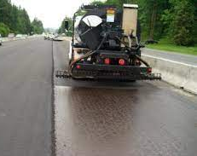
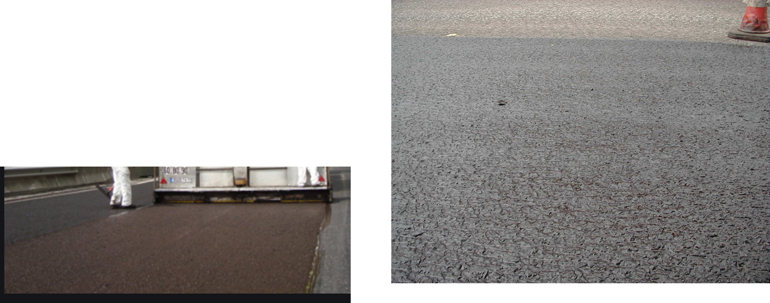
Desirable application –
Uniform across the mat

Slide 27
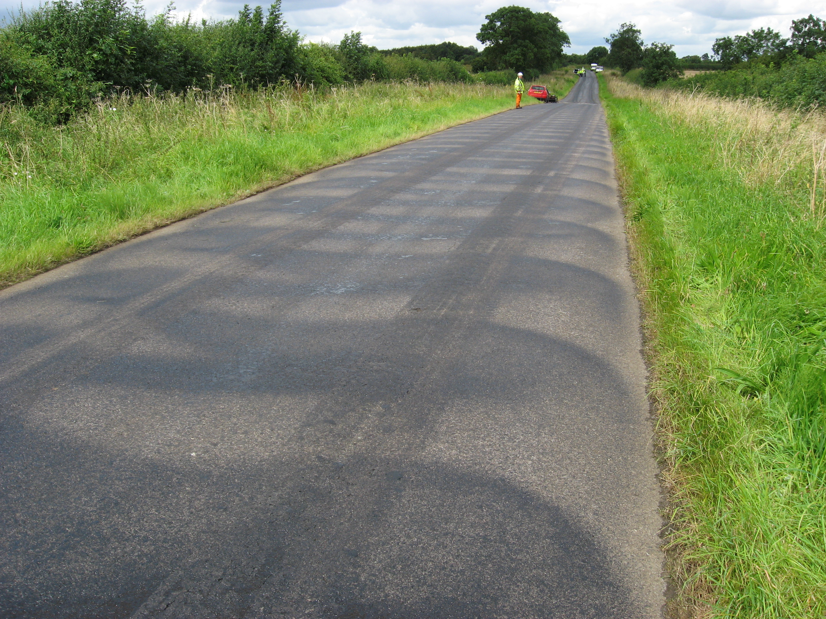
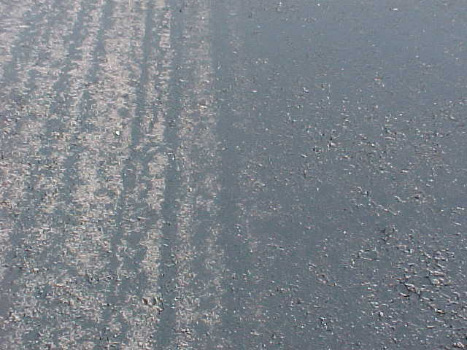
Undesirable – inconsistent application

Slide 28
application
Potential issue is the “complete break” of the emulsion
Contracts with night-time work and restricted access
Critical to maintain the required application rate
Stability is weather dependent

Slide 29
The future
Significant challenges coming up that will potentially make bonding and waterproofing even more critical
Intense wet
periods
More temperature extremes
Electric vehicles
Driverless vehicles
Etc etc….

Slide 30
Arash Khojinian, Head of Pavements for Highways England, says:
“Increasing the durability of the pavements on England’s strategic road network is vital. Properly bonded, well-designed asphalt layers are key to building longer-lasting pavements. Not only does the bond coat create a single uniform structure of the pavement, but it plays a critical role in protecting the lower layers from ingress of water. Correct specification and application of bond coats is essential if we want to see long-term improvement in the quality of England’s motorways and major roads”.
Arash Khojinian, Head of Pavements for Highways England, says:
“Increasing the durability of the pavements on England’s strategic road network is vital. Properly bonded, well-designed asphalt layers are key to building longer-lasting pavements. Not only does the bond coat create a single uniform structure of the pavement, but it plays a critical role in protecting the lower layers from ingress of water. Correct specification and application of bond coats is essential if we want to see long-term improvement in the quality of England’s motorways and major roads”.

Slide 31
www.rea.org.uk
www.rsta-uk.org
MAKE IT HAPPEN!
Execute
Design
Control
Specify

